Slide 1

Class 6: Toward Integrated, Holistic Natural Resources Management?
Larry Swatuk
lswatuk@mta.ca

Slide 2
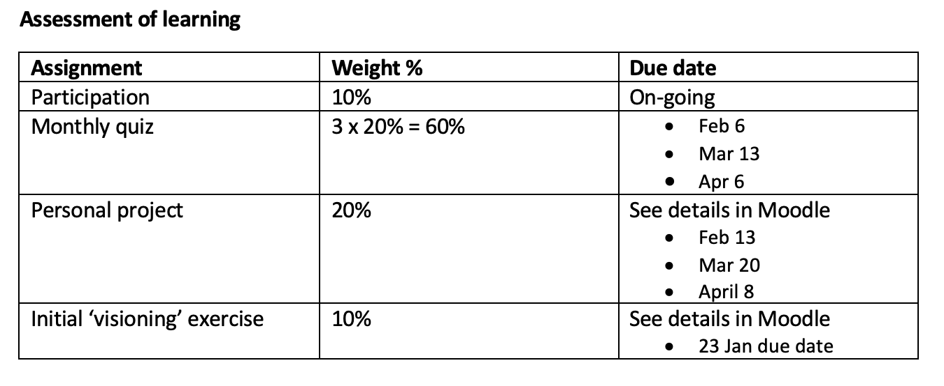

Slide 3
Personal Project Assignment = 20% of total
Step 1 (weight of total = 10%) (due Feb 13) EARLY THINKING
Title of your project
3-4 sentences describing the issue to be investigated
3 sources that inform your project (at this early stage they can be from any source)
Step 2 (weight of total = 20%) (due Mar 20) GETTING ORGANIZED AND READY TO WRITE
Sectional layout of your project including 2-3 sentences under each section telling your reader what is to be described in this section
7 sources that are a mix of peer-reviewed journal articles, legacy media stories, International Organization or Government reports, think tank and/or NGO reports (this demonstrates that you know how to conduct research and organize your thinking)
Step 3 (weight of total = 70%) (due last day of classes) WRITING AND SUBMITTING YOUR REPORT
A polished final paper that mirrors those that appear in The Conversation
See for example this report: https://theconversation.com/canadas-north-is-warming-from-the-ground-up-and-our-infrastructure-isnt-ready-272005 which is 1000 words

Slide 4
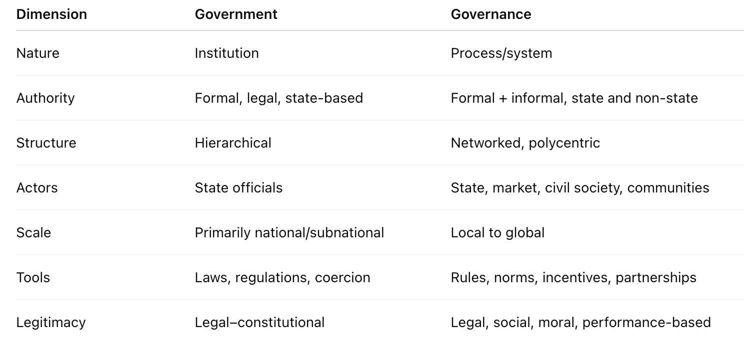

Slide 5
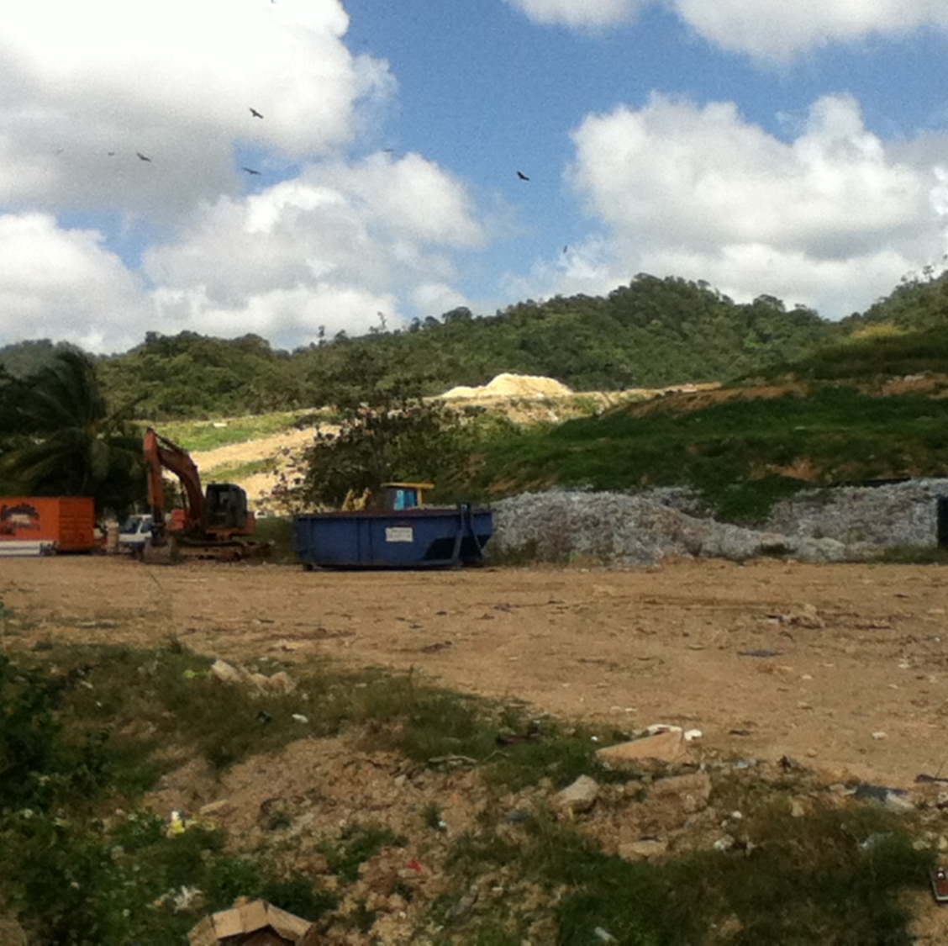
Governance
Governance is both outcome and process, involving a variety of legitimate and authoritative actors.
Good governance can never reach an end point; as a process it depends on the reiteration of activities that deepen trust
Notes:
As an outcome it reflects settled social relations. If it is good, it suggests widespread – if not universal – social approval of its practices. It is most readily constituted and observable at a local level, so raising questions about the fungibility of effective local governance, in particular the ways and means of moving from one socio-geopolitical scale to another.

Slide 8
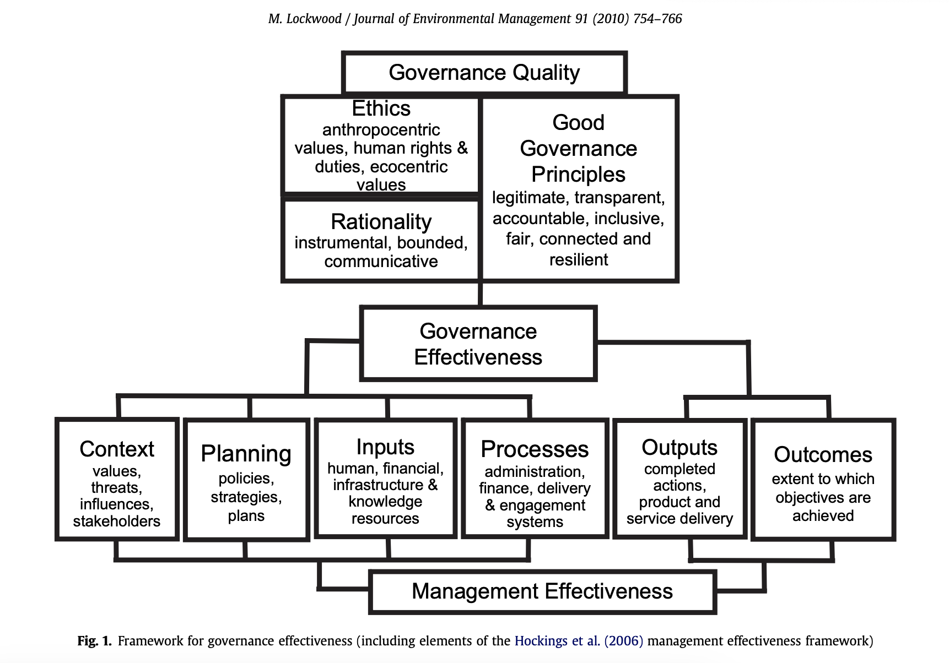

Slide 9
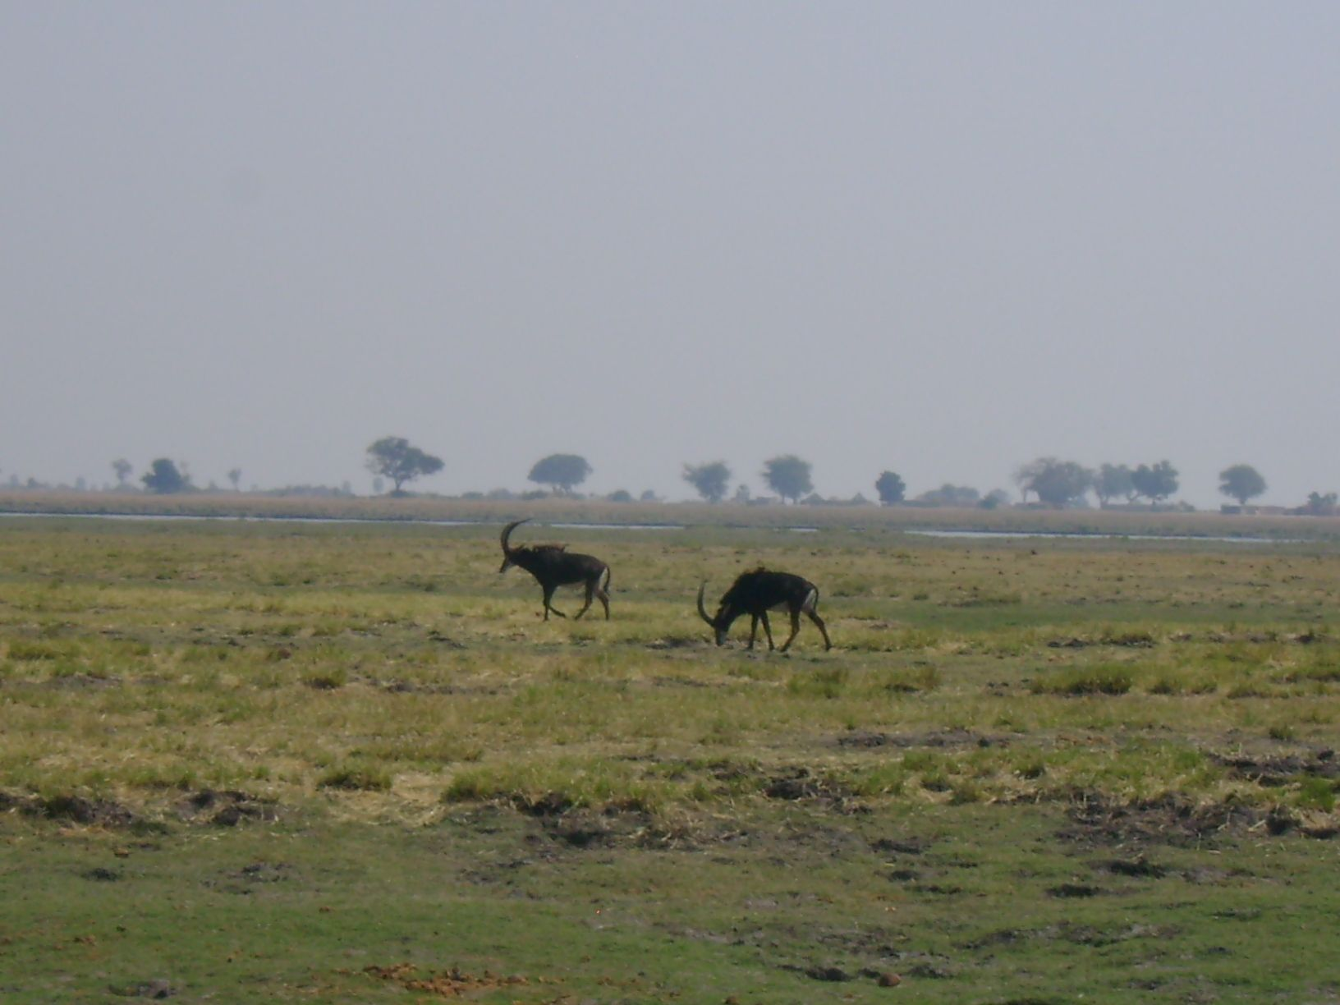
“Integrated planning and management for sustainable, equitable, efficient development”
Governance
Management
Determines who decides
Sets rules and goals
Allocates rights and responsibilities
Ensures legitimacy and accountability
Plans and implements actions
Applies technical and administrative tools
Monitors and enforces compliance
Produces measurable outcomes

Slide 10

Beyond “Command and Control”
‘[I]t is often presumptuous to believe that humans “manage” environment and resources. More realistically, humans manage their interactions with environment and resources. For that reason, uncertainty (as a result of imperfect understanding), as well as ignorance, and conflict (as a result of many different and legitimate interests) are common. Furthermore, the complexity of biophysical and socio-economic systems is great, and is exacerbated by ongoing change, some of which is influenced or caused by human activity. Thus, to deveiop policies, programmes or plans for resource and environmental management, or to be able to appraise the effectiveness of initiatives, it is important to be able to recognize and deal with change, complexity, uncertainty and conflict.’
— Bruce Mitchell, 2002, Resource and Environmental Management, p. 346.

Slide 11
Adaptive Governance
Governance shapes management by defining objectives, constraints, decision authority, accountability mechanisms
Management cannot compensate for illegitimate governance
Management feeds back into governance through monitoring results; revealing conflicts, demonstrating rule effectiveness, triggering reform and adaptation
This is the basis for adaptive governance
Governance and management are distinct but inseparable: governance provides direction and legitimacy, while management provides execution and learning.

Slide 12
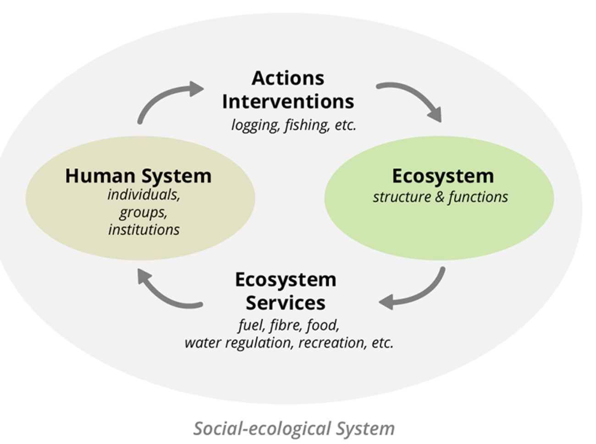
Socio-Ecological Systems Approach

Slide 13
Socio-ecological systems
A way of understanding and managing human–environment interactions that emphasizes interdependence, feedbacks, uncertainty, adaptation, and multi-scale governance.
Humans are part of not apart from Nature
System structure is complex, adaptive and non-linear (uncertainty is explicitly acknowledged) --> gave rise to the precautionary principle
The primary focus is system resilience and sustainability
Knowledge is plural and co-produced
Governance is polycentric, multi-scalar and networked (emphasizes adaptive management and learning)

